Slide 1
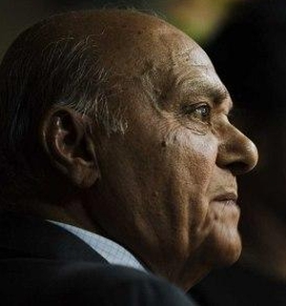
UNESCO Madanjeet Centre for Development Studies and Regional Cooperation (UMCDSRC)

Slide 2
Background
Currently 6 SAF scholars are studying 4 years of bachelors in development studies and regional cooperation
Kathmandu University is a reputed university of Nepal. There are 300 more Nepali students studying the same course alongside to the SAF scholars
A good local environment and a friendly visa regime of Nepal is a plus point for the course

Slide 3
Course Structure
Involves participatory approach and a lot of field visits
- Faculty are regular Professors of the KU.
At the end of the course, students will be awarded certificate from the University

Slide 4
Current SAF scholars
Atul Baluni (India)
Sahan Chathuranga (Sri Lanka)
Tshering Dema (Bhutan)
Bodipreo Tongchongya (Bangladesh)
Urishna Shakya (Nepal)
Santosh Pandey (Nepal)

Slide 5
Salient Features of the Course
SAF scholars participate in regional events and conferences; thereby get to know the value of regional cooperation in South Asia
No other Institution in Nepal has students from other SAARC nations studying the same course in the same college with local students
They value the scholarships provided by the SAF and are submitting regular progress reports

Slide 6
Visit to Lumbini, Bhaktapur and other UNESCO Heritage Sites

Slide 7
Hostel Facility

Slide 8
Alumni of Other SAF Institutions
Nepal has a maximum no. of SAF alumni from ALL SAF Institutions of Excellence
They are connected in the wider network of SAF alumni through the social media
Greater need to establish a formal mechanism to regularly interact with them and help them in career

Slide 9
Current Status of SAF Alumni in Nepal
They are working in the media, colleges, and NGOs
One Under Secretary in the Nepal Government
Most Chennai graduates are in the media and also Nepal correspondents of various international newspapers.
Lahore graduates are mostly abroad
Pondicherry graduates wish to pursue their M.Phil and Ph.d

Slide 10
Shortcomings Lack of Visiting Faculty/Fellowships
Demand for visiting fellowships
Visiting faculty from other saf institutions would bring in new insights and promote sharing of experiences

Slide 11
Shortcomings-II
Chapters are not sending bright students
Challenge of making the stipend and fees uniform in all Institutions as individual countries have different systems
Students do not bring in basic requirement even when clear information given
Experience that with the progress of the course, expenses starts going down than going up (ex. 2012-13-14)
We are not enrolling new scholars in 1st year because MoU period finishes in two years.

Slide 12
Other Activities

Slide 13
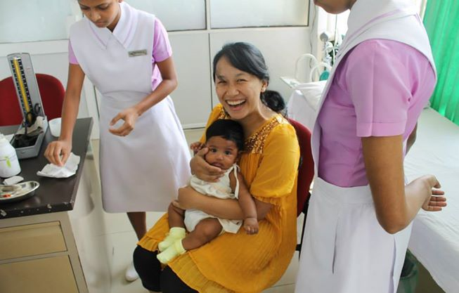
New Generation!

